Slide 1
For Sagar
How asymmetries in the input/feedforward signals are exploited by target neurons to elaborate feature selectivity

Slide 2
Radial Bias

Slide 4
Method
OI- What do we do?

Slide 5
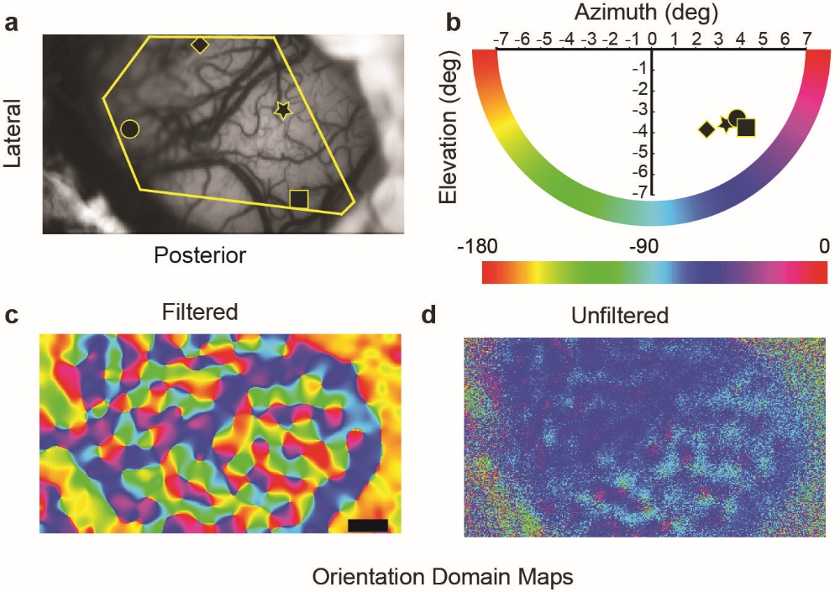
Unfiltered signal is mostly tuned to the radial orientation.

Slide 6
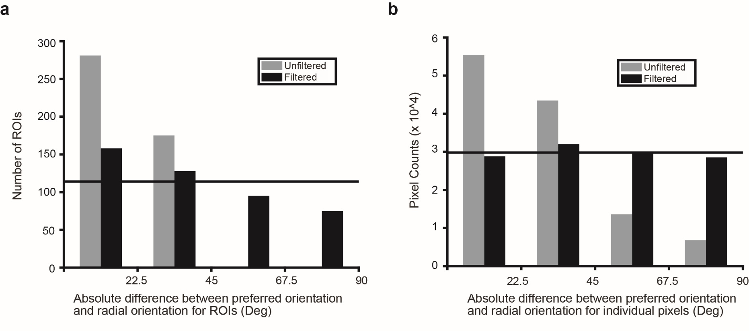
This tuning is on a fairly fine spatial scale

Slide 7
Also present on a single pixel level
ROI
Single Pixel

Slide 8
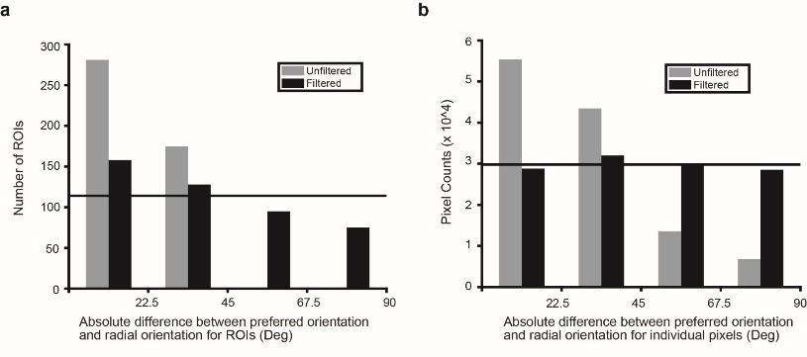
We also looked at array data
LFP data ~ Unfiltered
MUA data ~ Filtered

Slide 9
Superior Colliculus

Slide 10
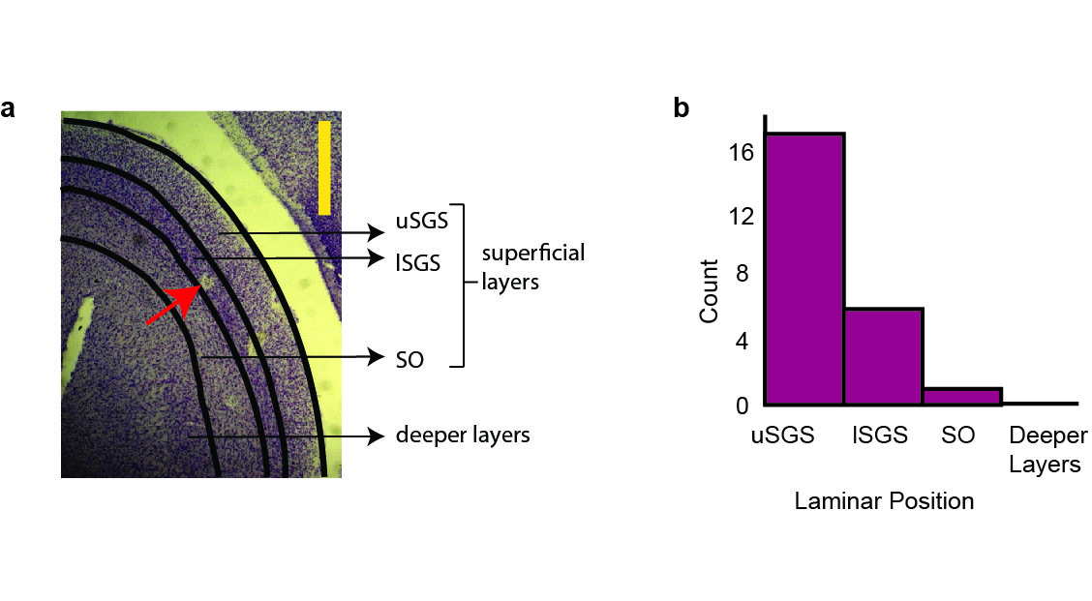
Most neurons were from the superficial (visual) layers

Slide 11
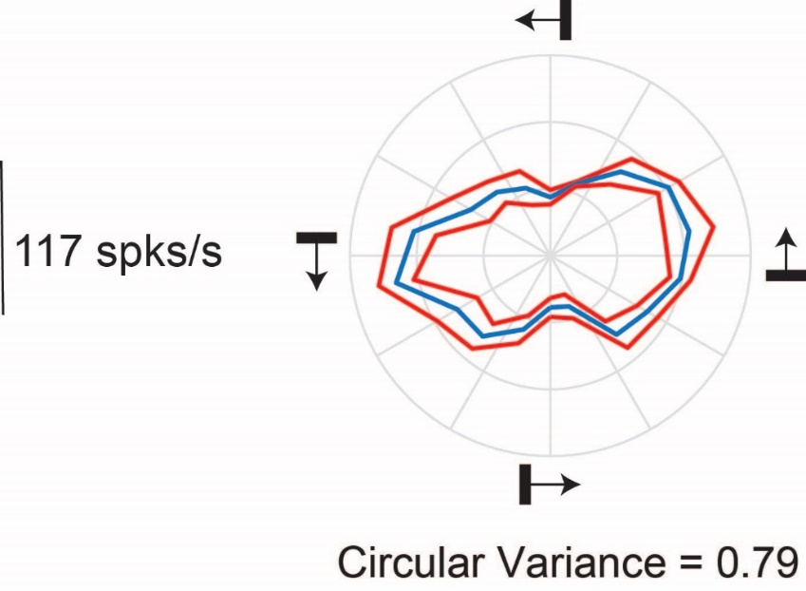
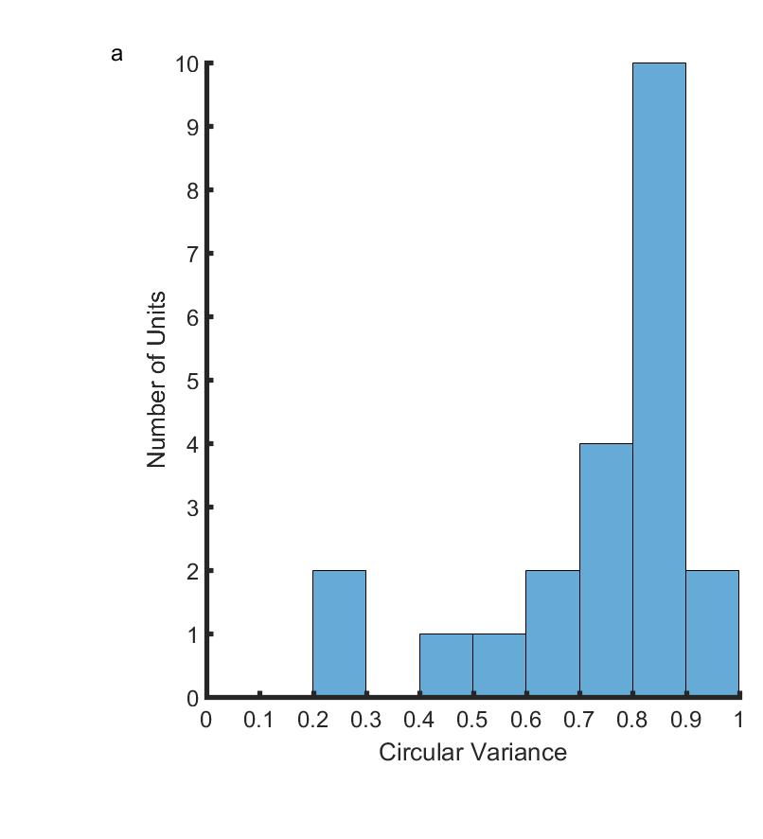
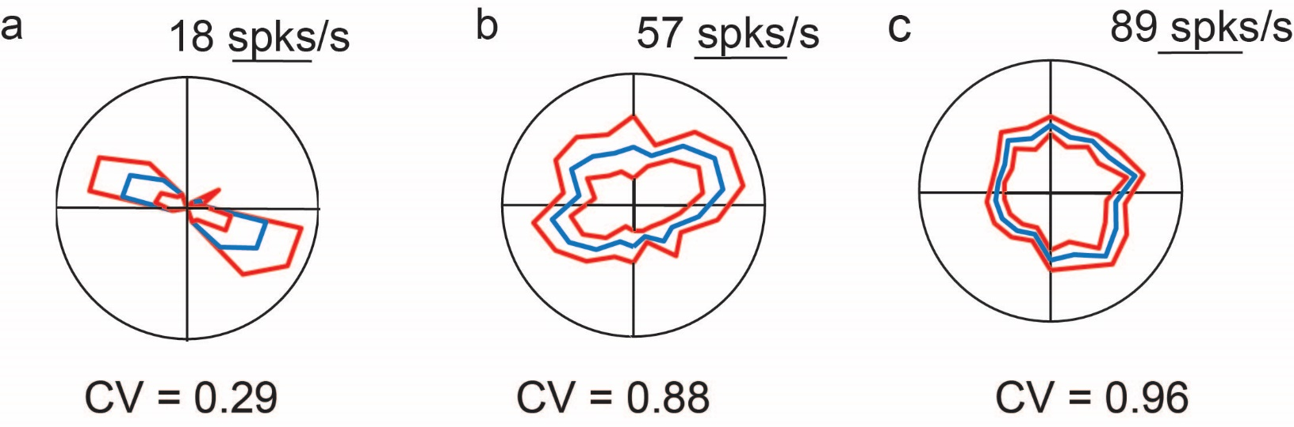
These neurons were orientation tuned in response to bars

Slide 12
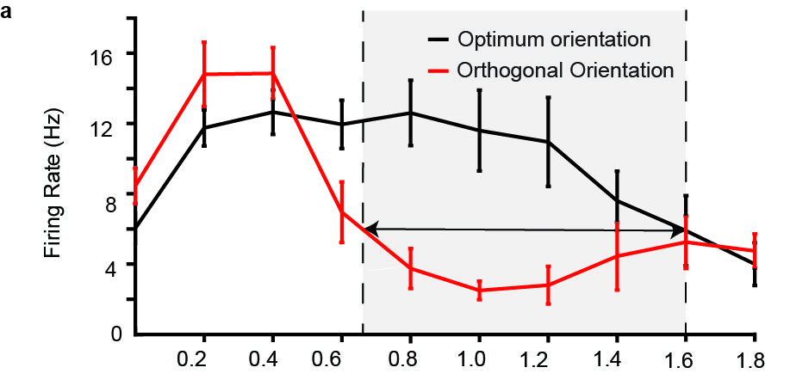
This orientation tuning was related to the spatial frequency of the stimulus

Slide 13
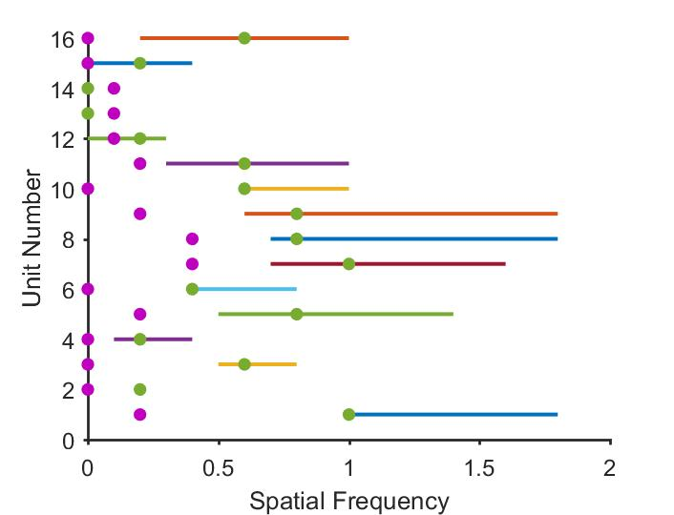
Orientation Selectivity is more prominent at higher spatial frequencies where the cortical neurons typically respond.

Slide 14
Primary Visual Cortex

Slide 15
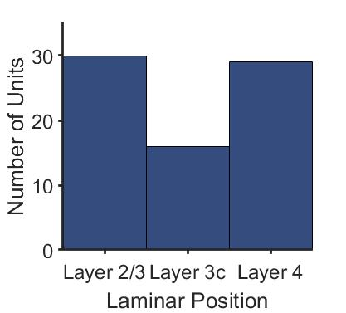
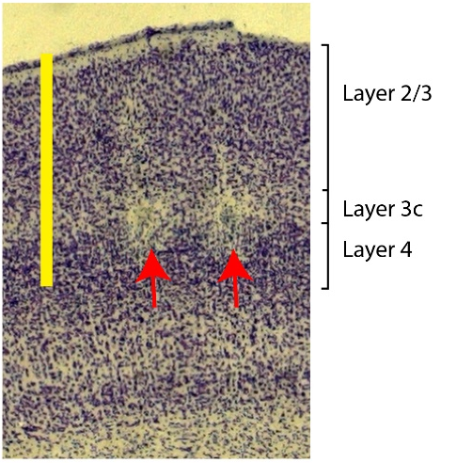
The cortical layers

Slide 16
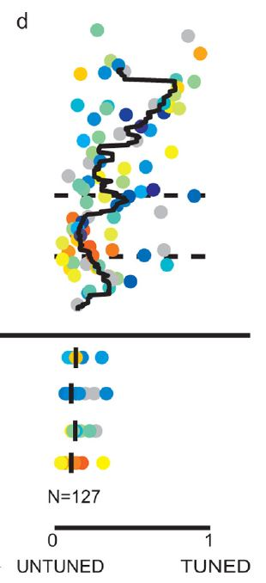
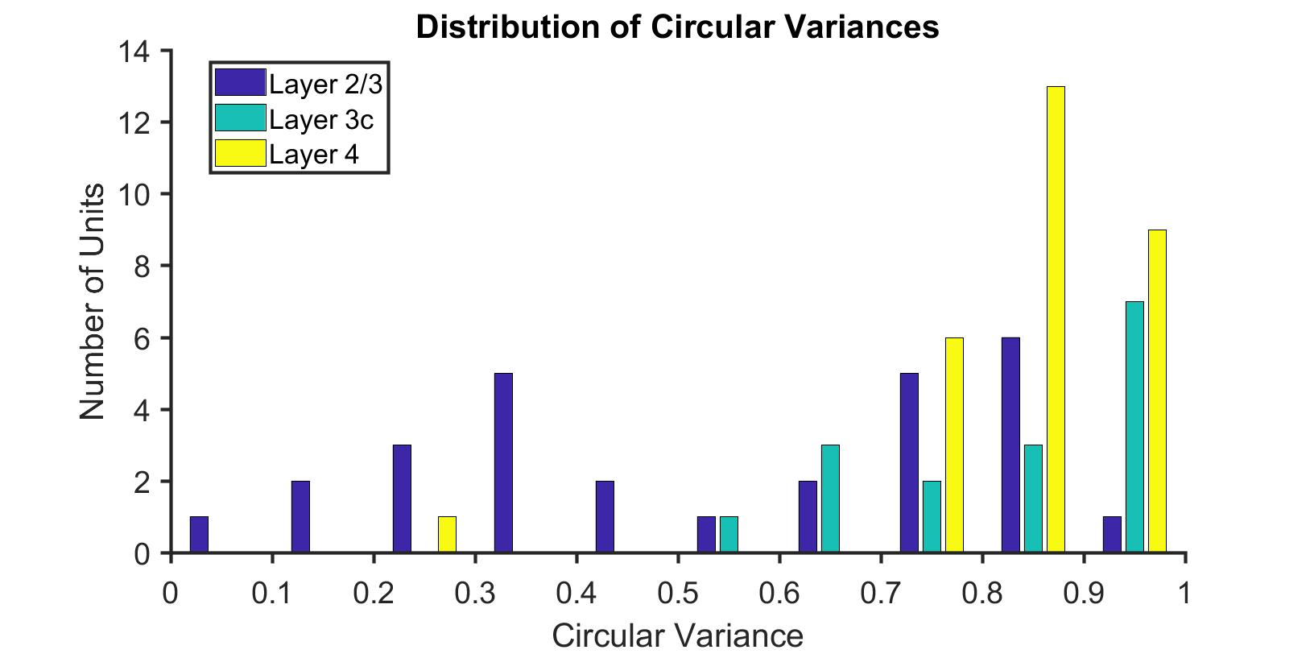
Distribution of Orientation Tuning in V1

Slide 17
Track Orientation
So far… layer 4 was thought to be unoriented.
Does the orientation remain same down the layers?

Slide 18
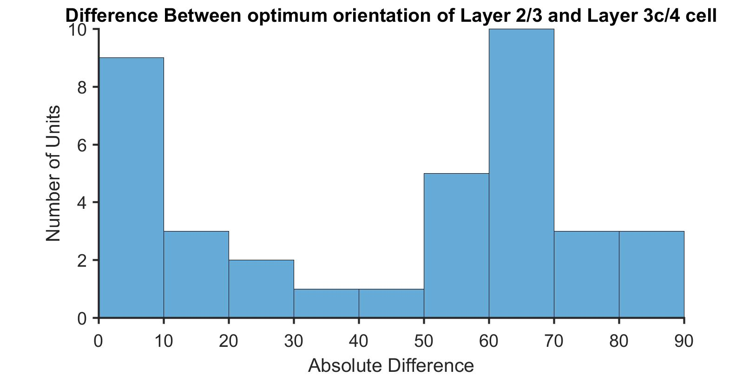
Orientation selectivity within a column
Difference in preferred orientation (cm) between layer 2/3 cell and the layer 3c/4 cell within a track
N=37 pairs

Slide 19
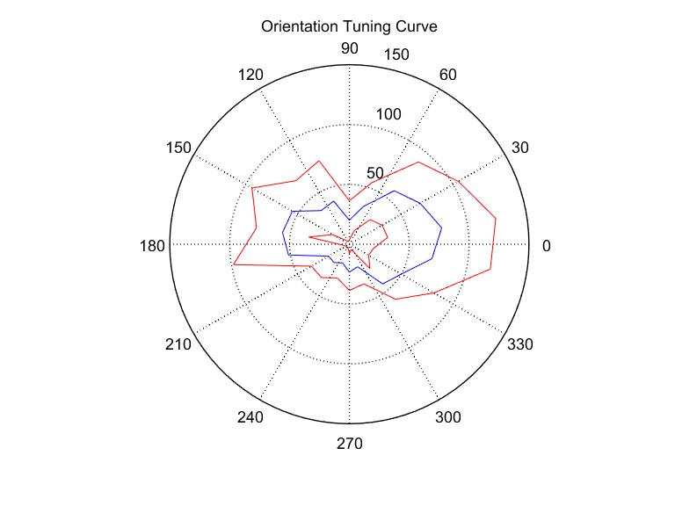
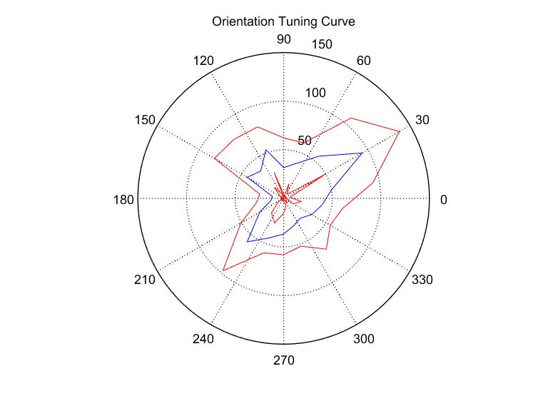
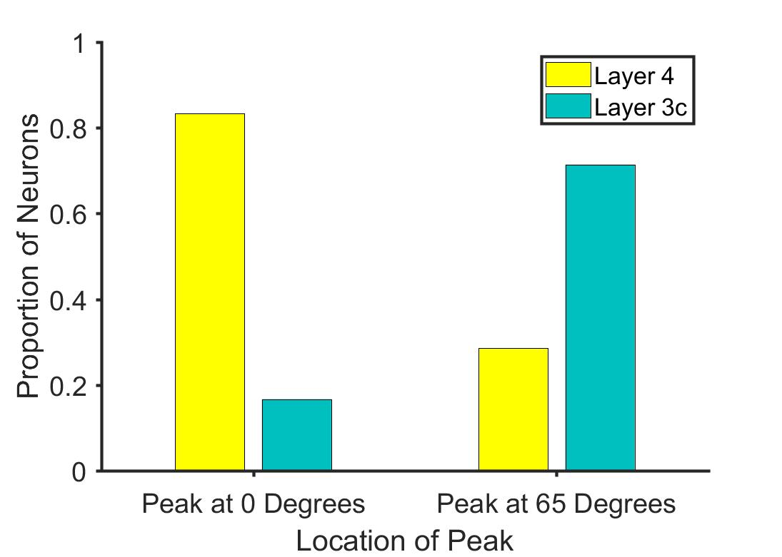
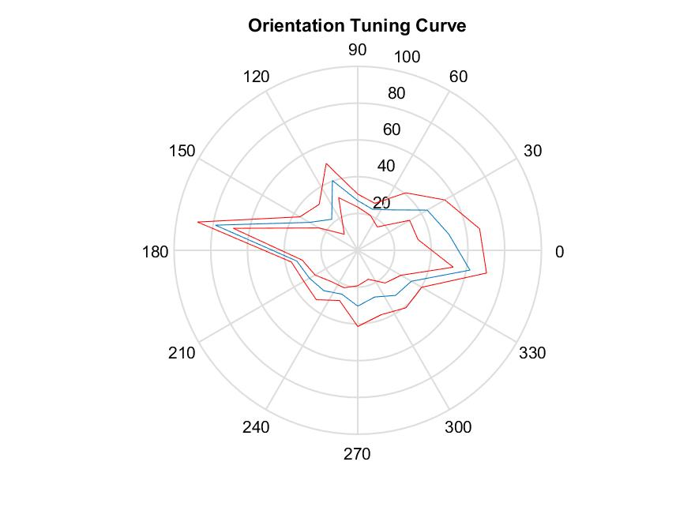
Layer 2/3
Cm= -5.7º
Layer 3c
Cm= 60.36º
Layer 4
Cm= 174.75º
P=0.016, Binomial Distribution
N=12
P=0.026, Binomial Distribution
N=21

Slide 20
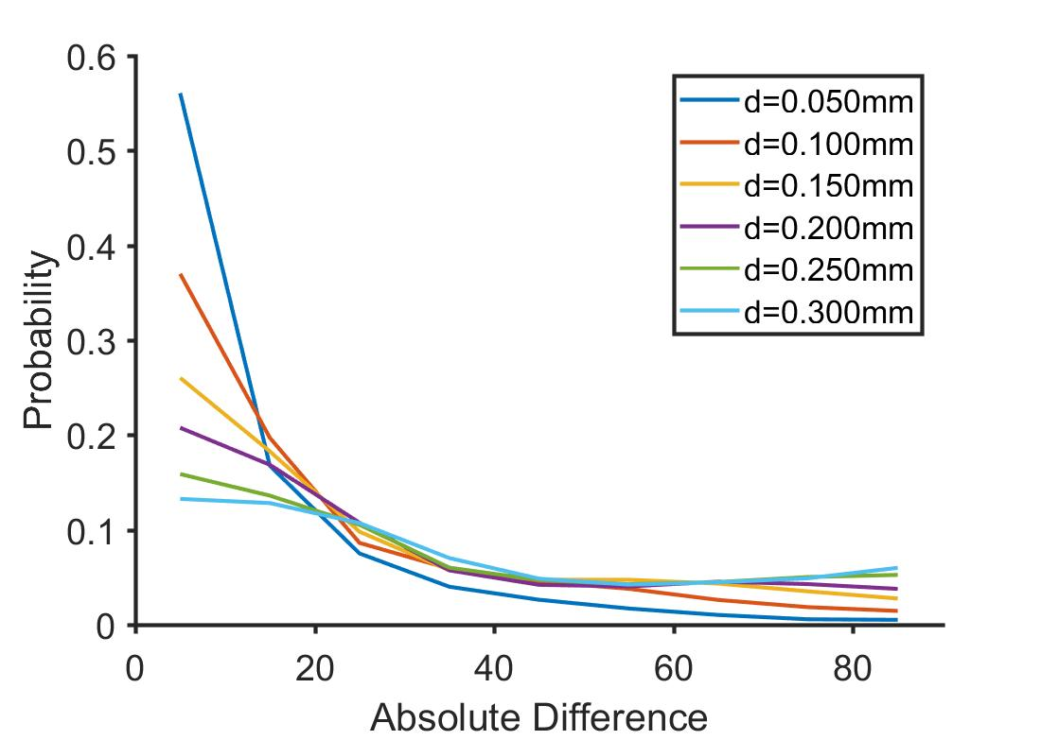
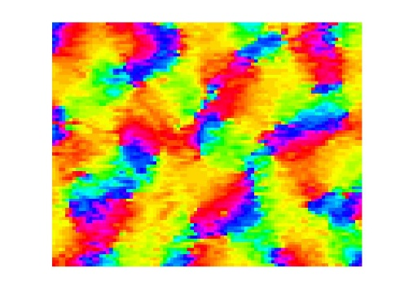
Orientation selectivity within a column- Is it chance?
Probability of getting a peak at 65º
Highest at d=0.25; p=0.045
Lowest at d=0.05; p=0.01

Slide 21
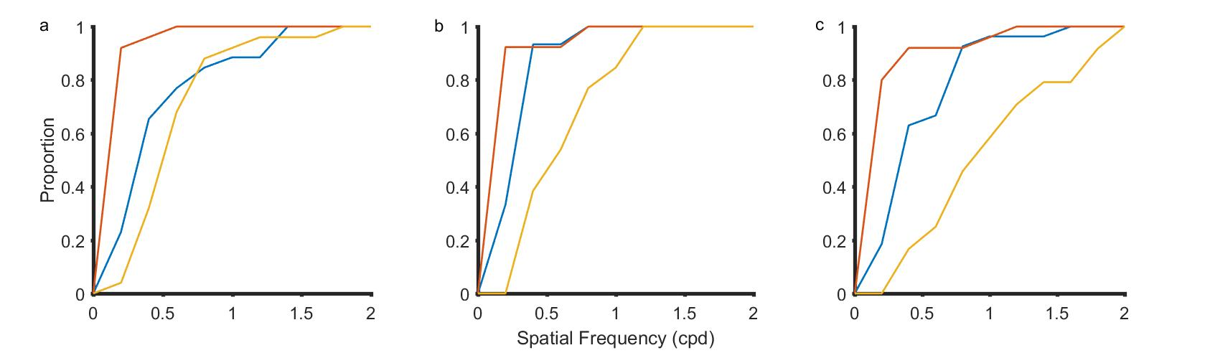
Spatial Frequency Tuning
Organisation
It’s role in orientation tuning
Layer 4
Layer 3c
Layer 2/3

Slide 22
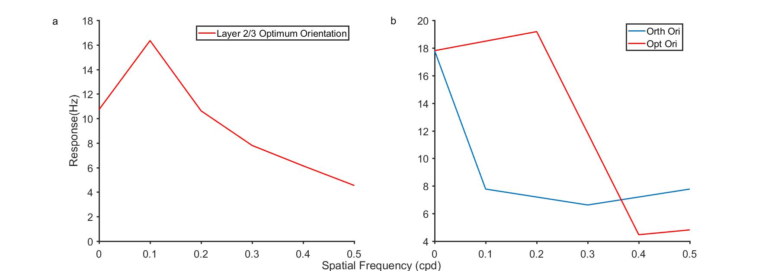
Spatial Frequency Tuning and orientation tuning (Layer 2/3 and input layer cells)

Slide 23
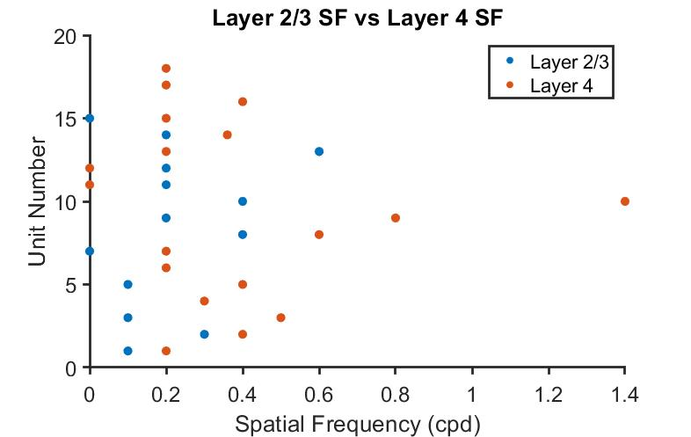
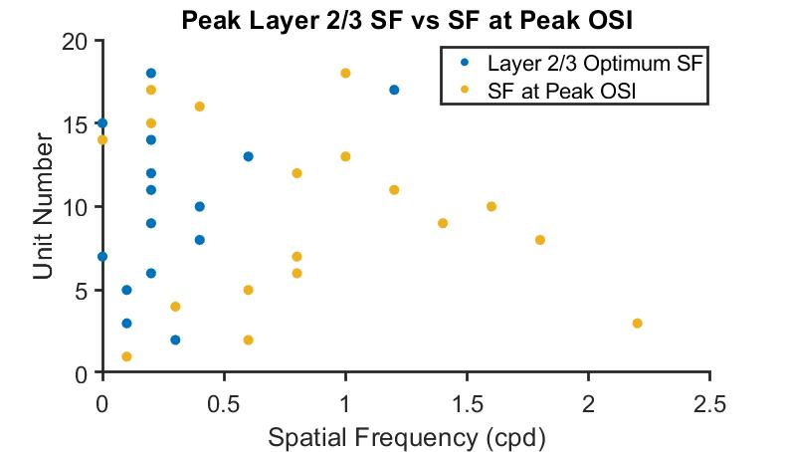

Slide 24
Modulation ratio and segregation index

Slide 25
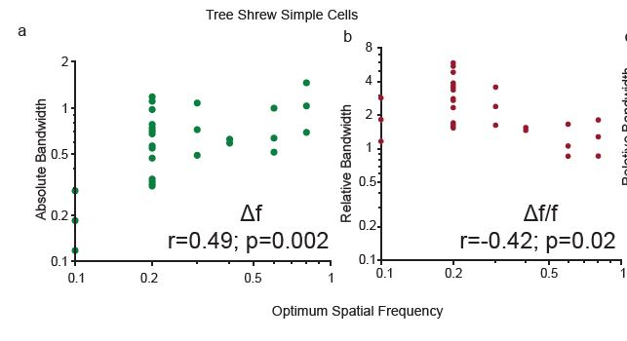
Are shrew simple cells ideal fourier transformers

